Slide 1

Seasonal Agriculture Performance Analysis
Nitish Bhardwaj
Panipat Institute of Engineering and Technology
AICTE STU ID : STU6a26a9143d65f1780918548

Slide 2

PROBLEM STATEMENT
Agricultural activities are influenced by seasonal variations in environmental conditions, farming practices, resource availability and market conditions. As a result, agricultural performance may differ from one season to another. However, raw agricultural data does not clearly explain how agricultural performance changes across seasons or what patterns can be observed in different seasonal conditions. The problem is to analyze the given agricultural dataset and investigate seasonal differences in agricultural performance by identifying meaningful patterns, trends, relationships and variations within the available data.

Slide 3
Project Description
This project performs an end-to-end, evidence-based analysis of 4,000 farm-level records spanning India's three cropping seasons – Kharif, Rabi and Zaid – to understand how environmental conditions, resource usage and farming practices drive agricultural performance.
The workflow covers data cleaning and domain-grounded imputation, feature engineering (profit margin, cost/revenue per hectare), exploratory analysis of climate, soil, crop and irrigation patterns, formal statistical hypothesis testing (ANOVA, Kruskal-Wallis, Chi-Square), and two Random Forest models – a Yield Regressor (R² = 0.896) and a Profitability Classifier (83.5% accuracy, ROC-AUC = 0.913).
The findings feed into a three-pillar policy framework covering crop realignment, micro-irrigation adoption and precision input management, directly answering all 11 AICTE-mandated analytical questions on seasonal agricultural performance.

Slide 4

WHO ARE THE END USERS?
Farmers & Growers – choosing the right crop and irrigation method for Kharif, Rabi or Zaid
State & District Agriculture Departments – designing seasonal crop-advisory and subsidy programs
Agricultural Banks & Insurers – assessing seasonal risk before approving loans and crop insurance
Irrigation & Micro-Irrigation Equipment Suppliers – targeting drip/sprinkler adoption drives
Agri-Tech Researchers & Policy Analysts – using the yield/profitability models for planning tools

Slide 5

Technology Used
Python 3.11 – core analysis language
Pandas & NumPy – data cleaning, imputation and feature engineering
Matplotlib & Seaborn – seasonal, financial and environmental visualizations
SciPy – ANOVA, Kruskal-Wallis and Chi-Square hypothesis testing
Scikit-Learn – Random Forest Regression & Classification models
Jupyter Notebook – end-to-end reproducible analysis environment

Slide 6
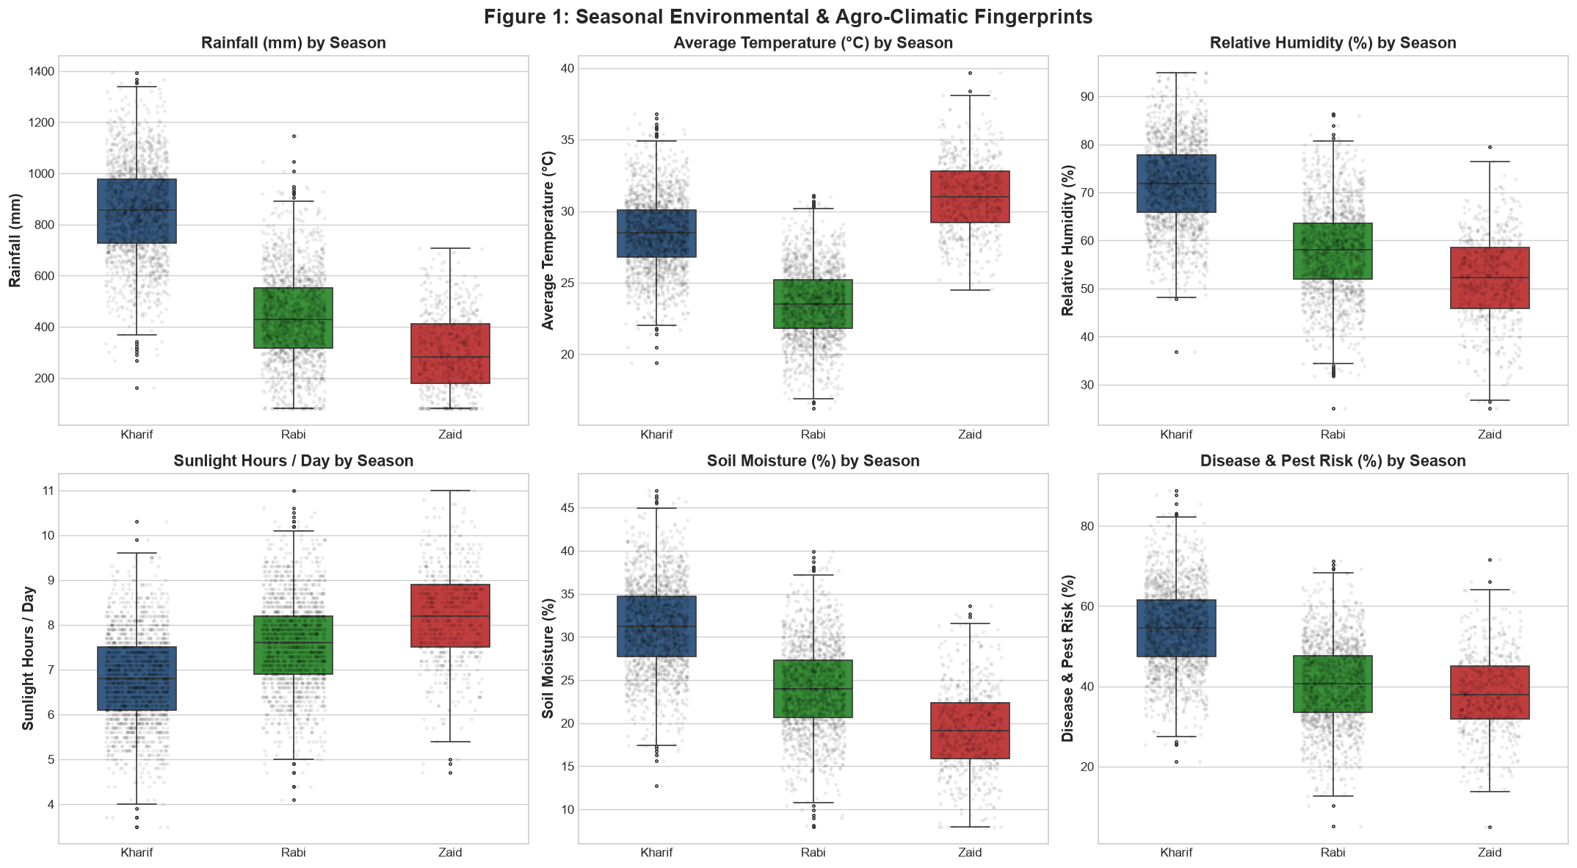
RESULTS – Environmental Profiles
Kharif: 816mm rain, 71.8% humidity
Zaid: 31.5°C avg, 19.2% soil moisture

Slide 7
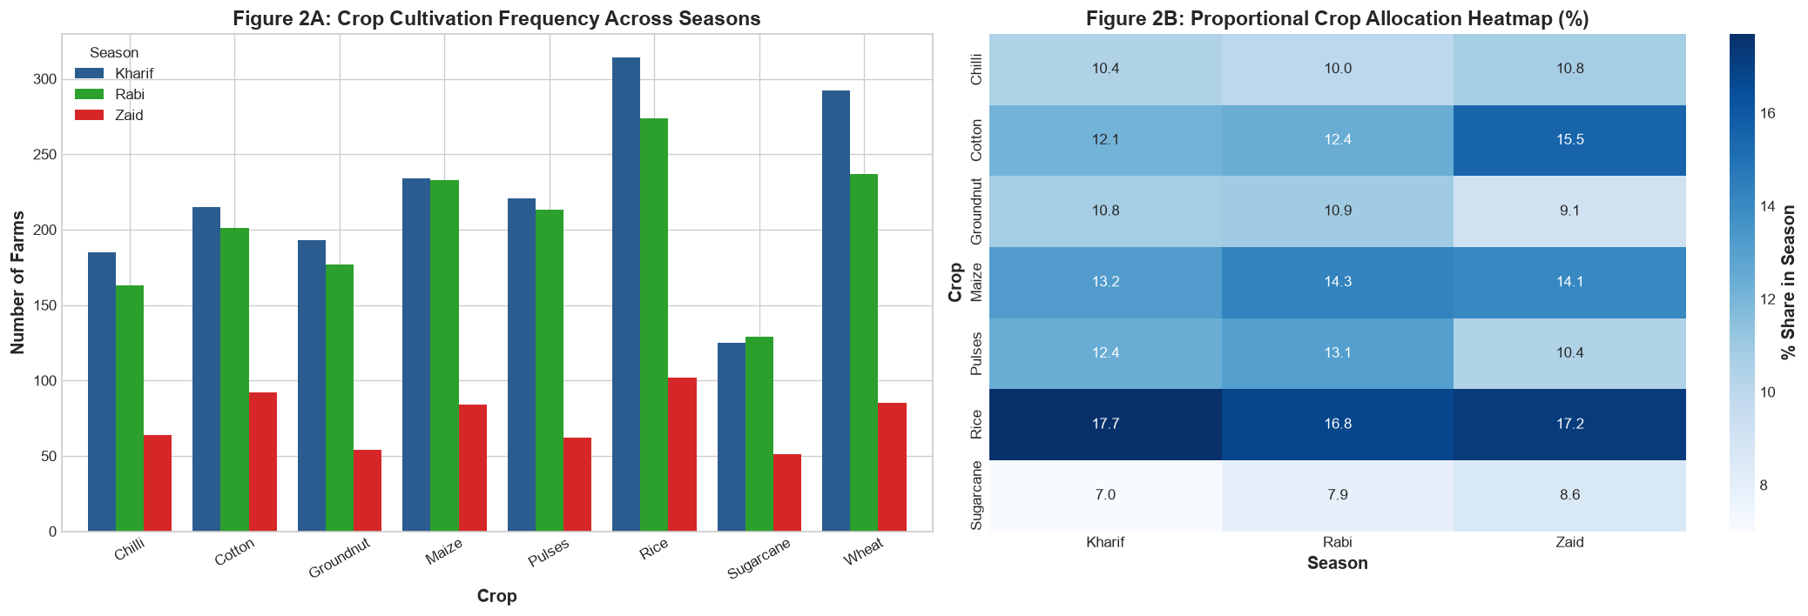
RESULTS – Crop Distribution
Rice is the top crop: ~17% share in every season
Crop selection is NOT season-dependent (Chi², p=0.455)

Slide 8
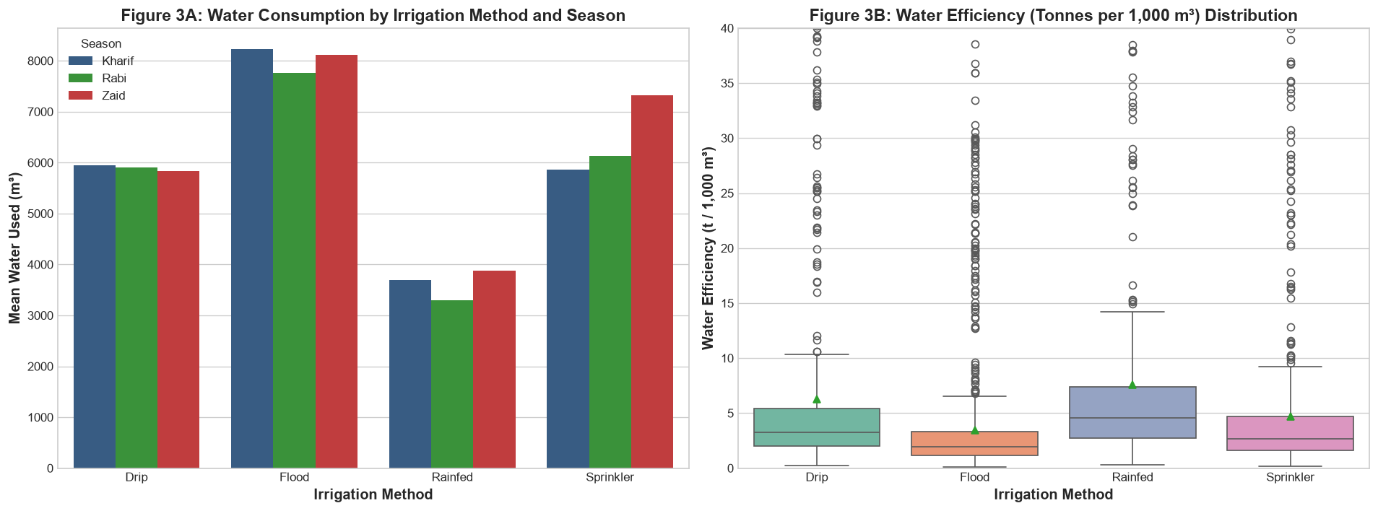
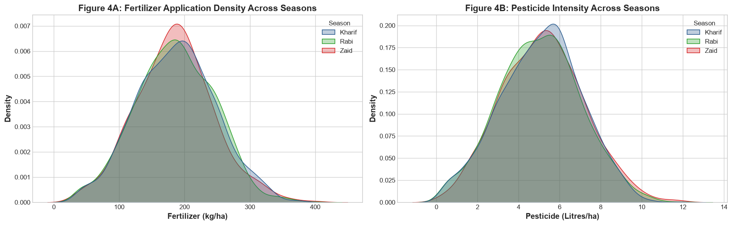
RESULTS – Resource & Irrigation Efficiency
Drip: 6.27 t/1,000m³ vs Flood: 3.44 t/1,000m³ efficiency
Fertilizer & pesticide intensity stay nearly flat across seasons

Slide 9
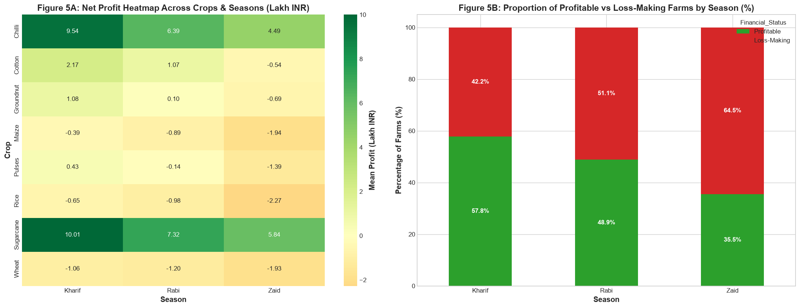
RESULTS – Profitability Analysis
Chilli & Sugarcane: up to ₹10 Lakh mean profit/season
Zaid farms: only 35.5% profitable vs 57.8% in Kharif

Slide 10
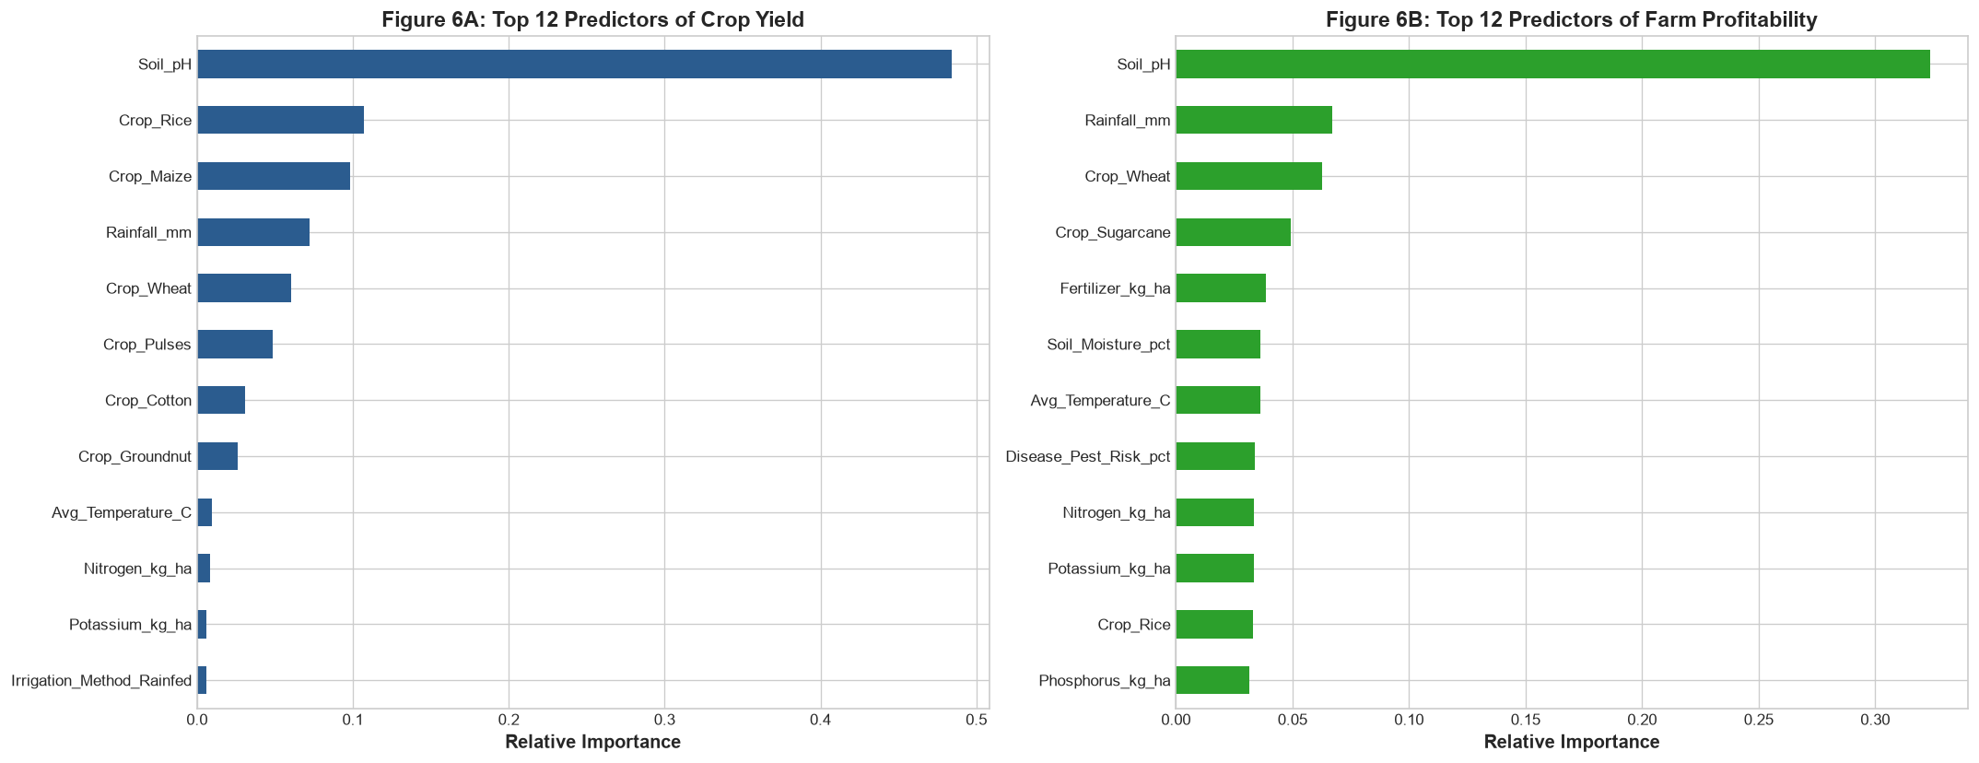
RESULTS – Predictive Modeling
Yield Model: R² = 0.896 | RMSE = 0.346 t/ha
Profitability Classifier: 83.5% accuracy, ROC-AUC = 0.913

Slide 11
Future scope
Real-Time Deployment
Broader Data & Region Coverage
Deploy the yield & profitability models as a live farmer-advisory web/mobile app with district-level, real-time weather and market-price feeds
Extend the dataset beyond 8 states to a pan-India, multi-year panel to capture inter-annual climate variability (e.g., El Niño years)
Incorporate satellite & remote-sensing indices (NDVI, soil moisture) to reduce dependence on self-reported farm data
Add a market-price forecasting module so profitability predictions adapt to real-time commodity price swings
Pilot the proposed micro-irrigation subsidy and pest early-warning framework with a state agriculture department

Slide 12
GitHub Link
https://github.com/nitish-sharma06/AgriPredict

Slide 13

VOIS Course completion certificate - Course name- Data Visualization
Course: Data Visualization (VOIS – Vodafone Idea Foundation)
Issued: August 31, 2026 | ID: VFLMS26_162658

Slide 14
Thank you
Nitish Bhardwaj
Panipat Institute of Engineering & Technology
nitishbtech6@gmail.com
.
.

